Slide 1
IMC: Managing Social Media

Slide 2
Overview
Key social media platforms
Engagement is the overriding goal
Paid, Earned and Owned Media
Social media challenges
Managing the brand’s social media efforts

Slide 3
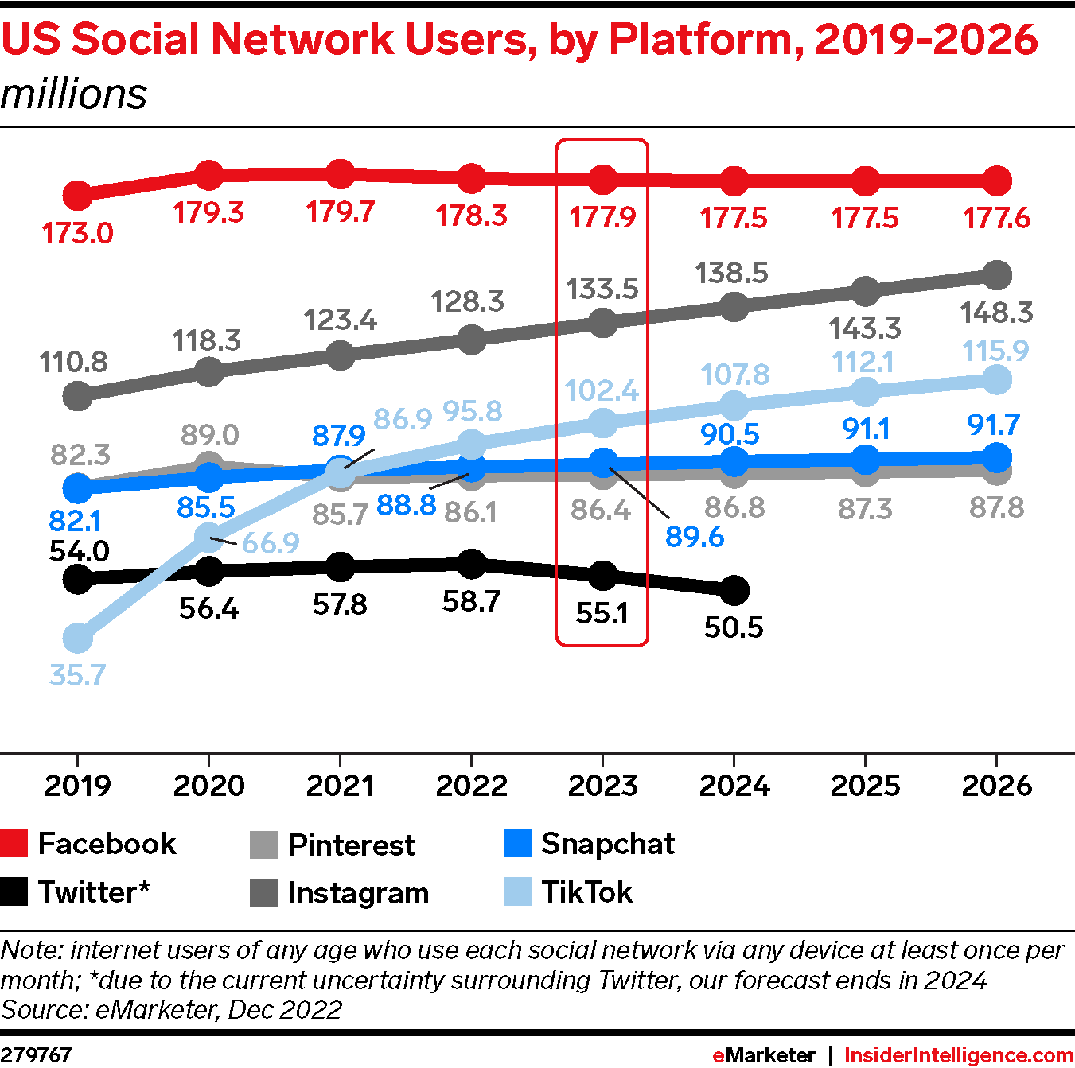
Key Platforms

Slide 4
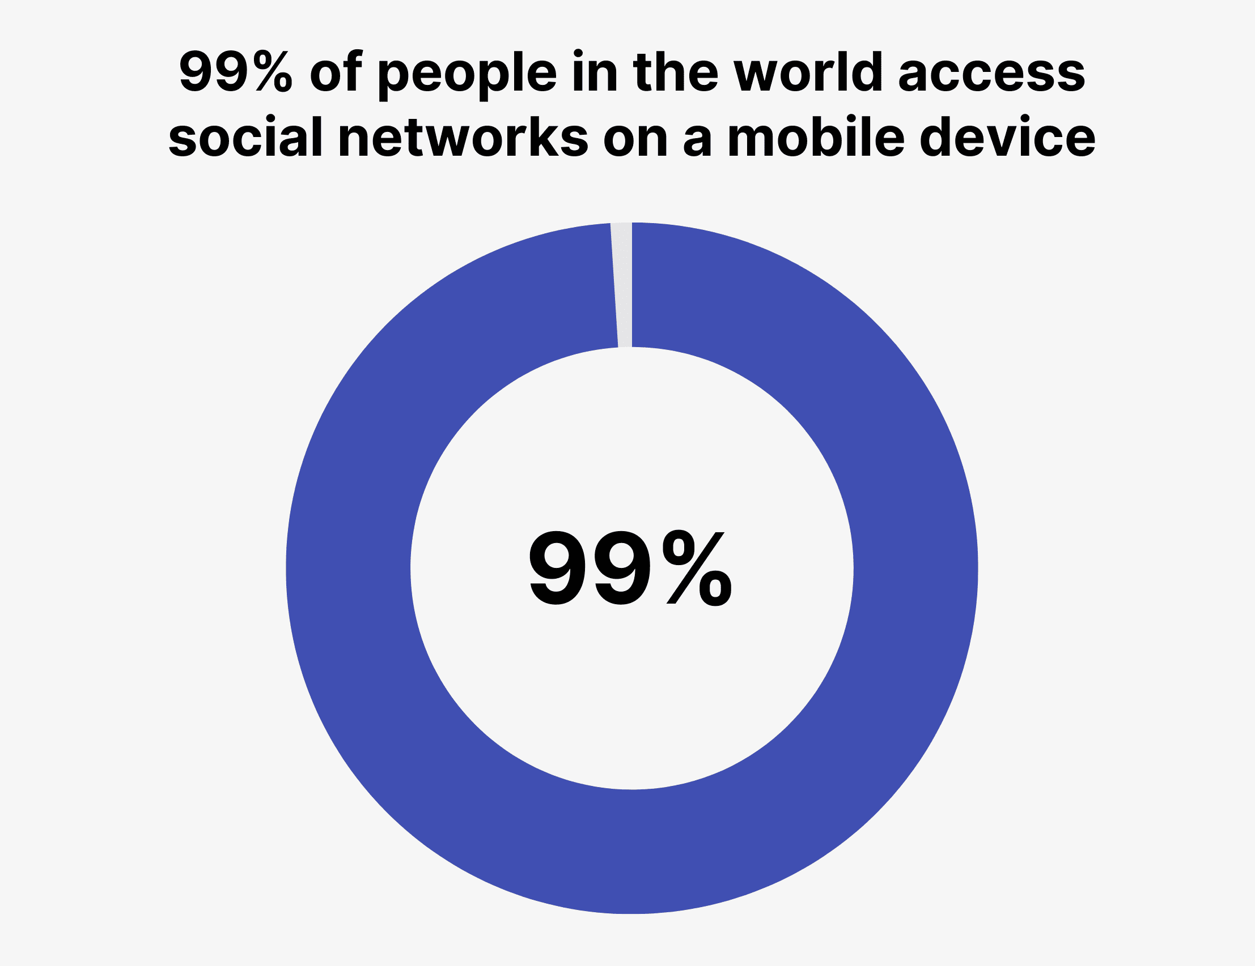
Social Media is Mobile
Source: GlobalWebIndex

Slide 5
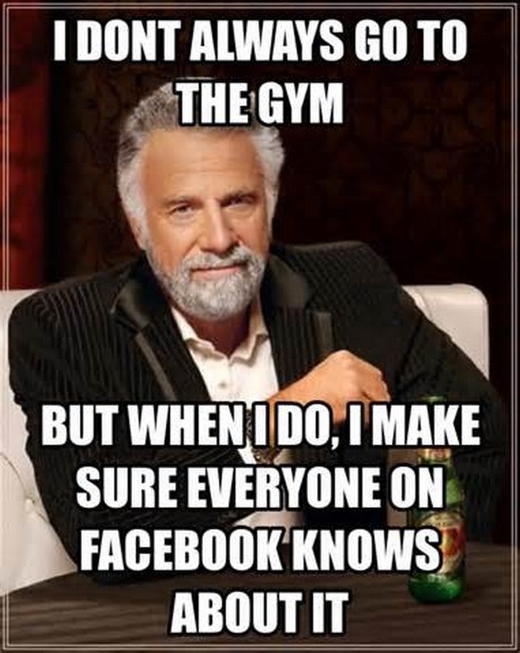
Managing the Social Media Effort
The goal is consumer engagement
Must be a dialogue
Must offer engaging content, not just promotions
Must be nimble and willing to relinquish some control
Ideally should be fun and entertaining
Need a dedicated staff to monitor and respond

Slide 6

Facebook Engagement
Most fans are “lurkers”
“Likes” are practically meaningless
Reactions other than a simple “like” are a bit more valuable
Comments are the mark of true engagement, but negative comments must be replied to meaningfully
Concerns about “brand safety”

Slide 7
Paid, Earned, and Owned Media
Paid media includes typical advertising messages, but also Facebook posts, tweets, Instagram posts, etc., by the brand.
Earned media includes consumer-generated posts, tweets, shares, comments, retweets, etc. (in essence, electronic word-of-mouth).
Owned media is “owned and operated” by the brand—e.g., a website, Facebook page, Twitter feed.

Slide 8
Models For Organizing Social Media Efforts
Centralized—direct report or CEO or CMO
  Coordination, continuity
  Narrow scope, slower
Distributed
  Breadth, immediacy, eclecticism
  Lack of standardization, foot-in-mouth
Combination
  Centralized best practices
  Rapid, localized execution

Slide 9
Social Media Challenges
Working with “digital natives”
Can go “off the rails”
Immediacy can blindside—must be vigilant 24/7/365
Ultimately, SM is about people, not brands
Tracking effectiveness and ROI is elusive

Slide 10
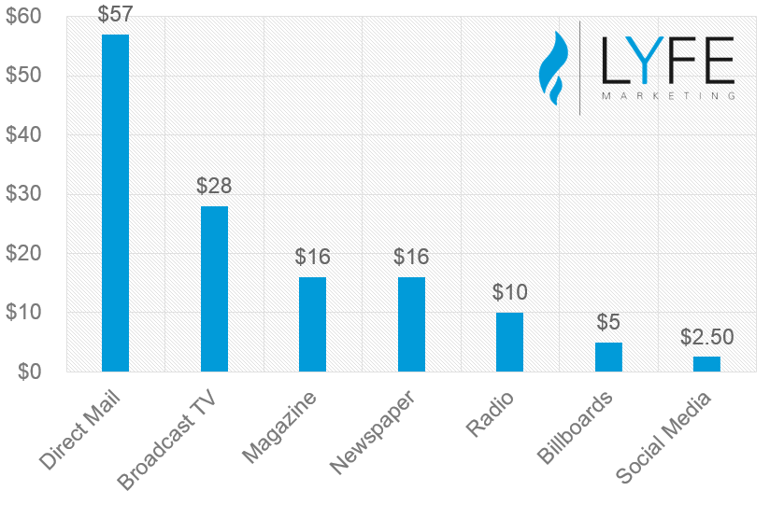
Cost Efficiency (CPM)

Slide 11
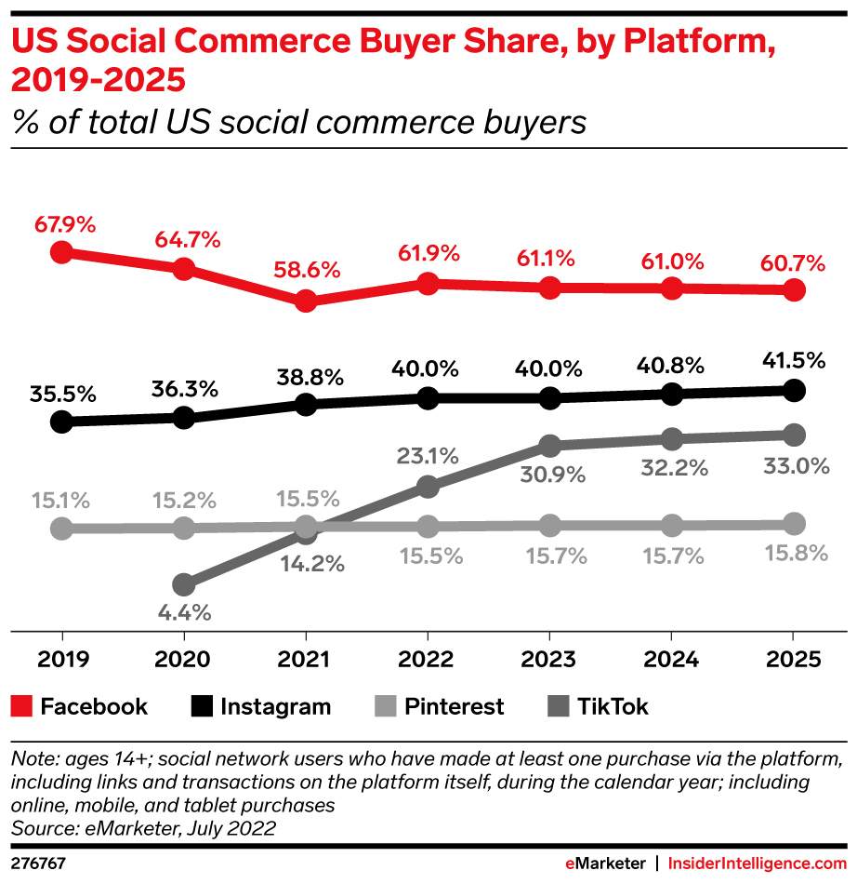
Social Commerce

Slide 12
Socialmention.com
Strength—likelihood brand is being mentioned on SM
Sentiment—ratio of positive to negative comments
Passion—likelihood of repeated mentions
Reach—ratio of number of unique commenters to total number of comments

Slide 13
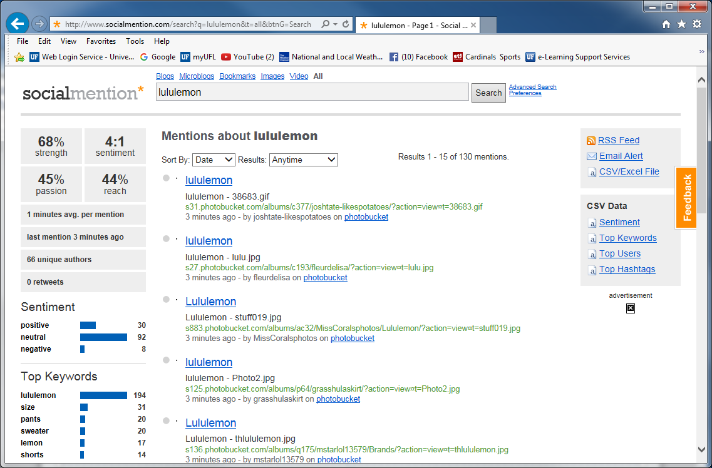
Socialmention.com example: lululemon

Slide 14
Conclusion
Does your firm use social media?
If so, is the social media effort managed effectively?
How is social media effectiveness assessed?
Do you actively participate in any branded social media as a consumer?

Slide 15
End of Lecture

